Slide 1
Digital Communication 22EC2208
Dr. M. Venu Gopala Rao
M.Tech, Ph.D(Engg) F.I.E.T.E, L.M.I.S.T.E, I.S.O.I., I.A.E., S.S.I.
Cert. in R.S.T ( City & Guild’s London Institute , London)
Professor, Dept. of ECE, K L University
mvgr03@kluniversity.in

Slide 2
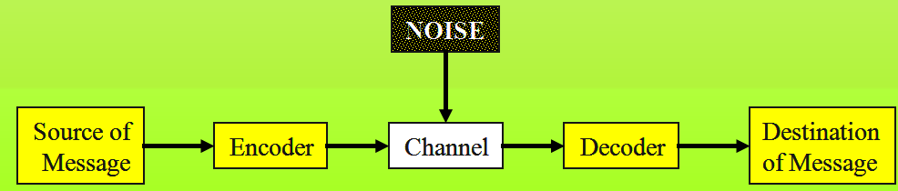
Introduction to Information Theory
Information theory is a branch of science that deals with the analysis of a communications system.
Claude Shannon Published a landmark paper in 1948 that was the beginning of the branch of information theory.
We are interested in communicating information from a source to a destination

Slide 3

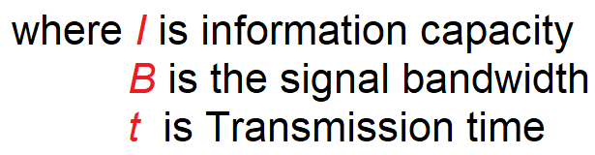
Information Theory
Information theory is a highly theoretical study of the efficient use of bandwidth to propagate information through electronic communications systems.
Information theory can be used to determine the information capacity of a data communications system.
Information capacity is a measure of how much information can be propagated through a communications system and is a function of bandwidth and transmission time.

Slide 4
Information capacity represents the number of independent symbols that can be carried through a system in a given unit of time.
The most basic digital symbol used to represent information is the binary digit, or bit.
Therefore, it is often convenient to express the information capacity of a system as a bit rate.
Bit rate is simply the number of bits transmitted during one second and is expressed in bits per second (bps).
Bit rate
$$f_{b}=2B\log_{2}{L, where L=2^{n}}$$

Slide 5

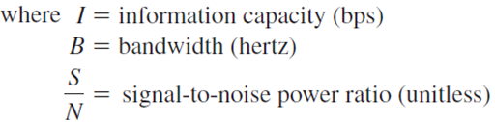
The information capacity is a linear function of bandwidth and transmission time and is directly proportional to both. If either the bandwidth or the transmission time changes, a directly proportional change occurs in the information capacity.
The Shannon limit theorem:
The higher the signal- to-noise ratio, the better the performance and the higher the information capacity.

Slide 6
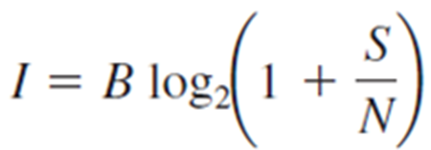


Problems and Solutions on Channel Capacity
Ex2. A telephone line normally has a bandwidth of 3000 Hz (300 to 3300 Hz) assigned for data communication. If the SNR is 3162, what will be the capacity for this channel?
Ans:

Slide 7



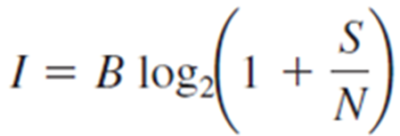


Problems and Solutions on Channel Capacity
Ex3. Calculate the theoretical channel capacity, if the channel having SNR of 36dB and the channel bandwidth is 2 MHz.
Ans:

Slide 8
Exercise questions
According to the Shannon-Hartley law, what is the maximum
achievable bit-rate for a computer modem operating over a
telephone channel with 3 kHz bandwidth and a maximum allowed
signal power that guarantees only a 30dB SNR?
2. A voice grade channel of the telephone network has a bandwidth of
3.4 KHz.
(a) Calculate channel capacity of the telephone channel for signal to noise ratio of 32 dB.
(b) Calculate the minimum SNR required to support information transmission through the telephone channel at the rate of 4800 bits/sec.

Slide 9
M-ary (Multi-level) Encoding
M-ary is a term derived from the word binary.
M simply represents a digit that corresponds to the number of conditions, levels, or combinations possible for a given number of binary variables.
It is often advantageous to encode at a level higher than binary where there are more than two conditions possible.
For example, a digital signal with four possible conditions (voltage levels, frequencies, phases, and so on) is an M-ary system where M = 4
If there are eight possible conditions, M = 8 and so forth.

Slide 10


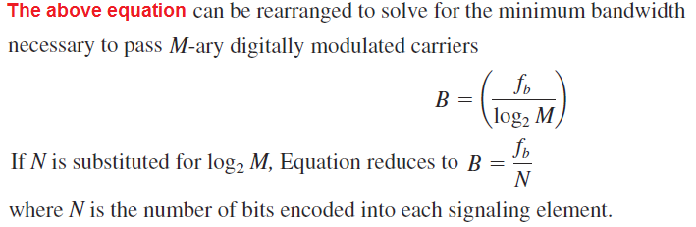
M-ary signals:
If more than two levels are used for signaling (higher-than-binary encoding), more than one bit may be transmitted at a time, and it is possible to propagate a bit rate that exceeds 2B.
Using multilevel signaling, the Nyquist formulation for channel capacity is

Slide 11
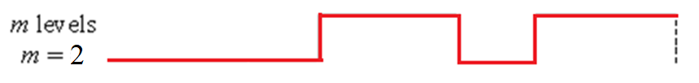
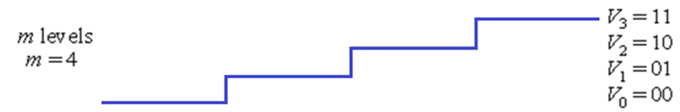
M-ary Encoding
Binary
4-ary

Slide 12
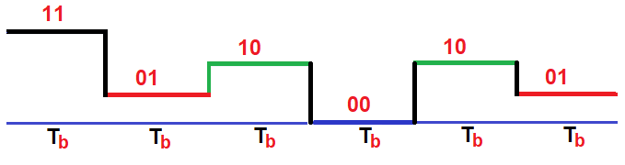

Slide 13



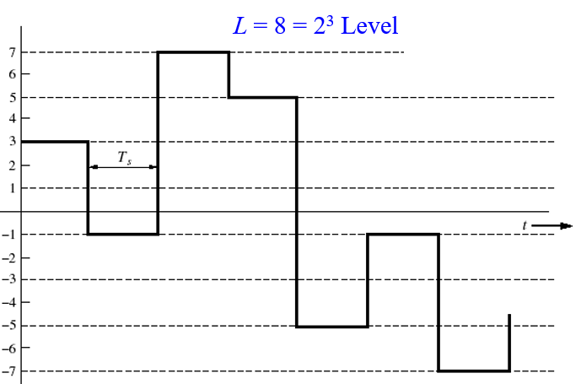
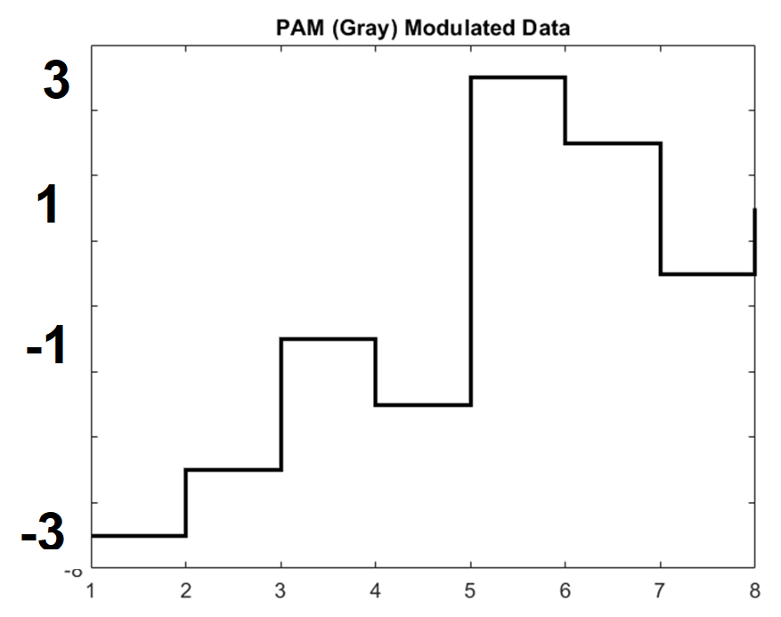
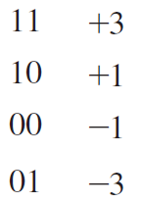
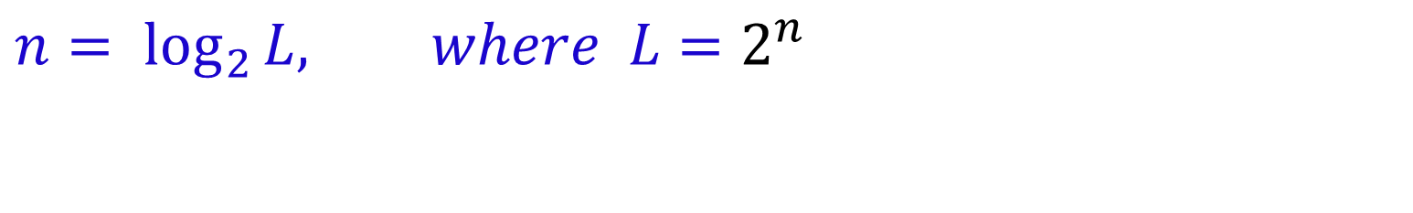
$$n=\log_{2}{L, where L=2^{n}}$$

Slide 14
There are three reasons for the emphasis of Discrete PAM:
Discrete pulse-amplitude modulation is simple to analyze.
2. It is the most efficient form of discrete pulse modulation in terms of both power and bandwidth use.
3. The analytic techniques developed for handling discrete pulse-amplitude modulation may be extended to other discrete-pulse modulation techniques using phase or frequency.

Slide 15
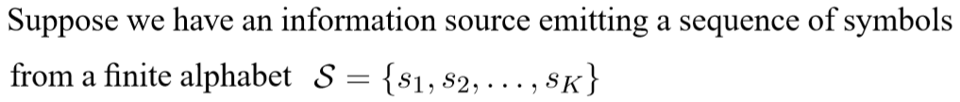
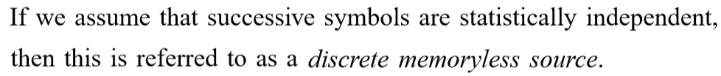
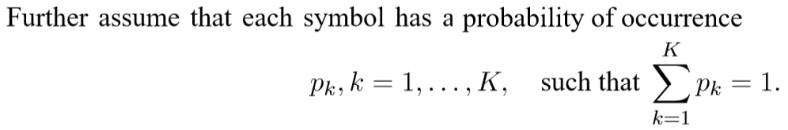
Discrete Memoryless Source
Source
s₁, s₂, …

Slide 16
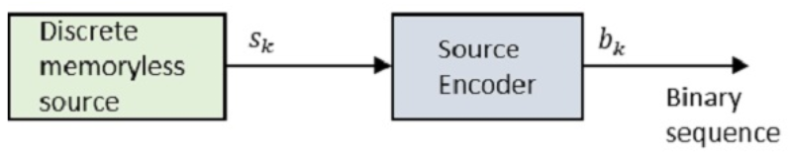
Source Coding
A conversion of the output of a discrete memoryless source (DMS) into a sequence of binary symbols (i.e., binary code word) is called source coding.
Efficient representation of discrete source.
Two functional requirements.
The code words produced by the encoder are in binary form.
The source code is uniquely decodable, so that the original source sequence can be reconstructed perfectly from the encoded binary sequence.

Slide 17
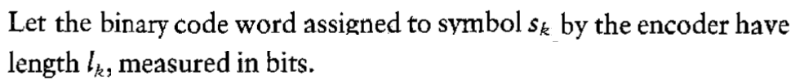
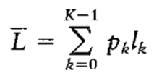
Source encoder …
The device that performs this conversion is called the source encoder. Figure shows a source encoder.

Slide 18
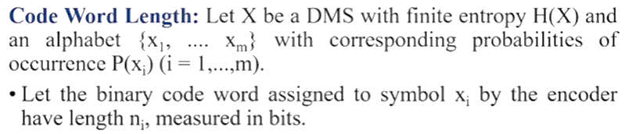
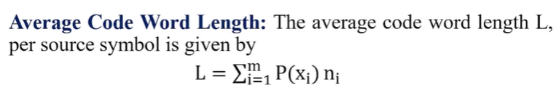
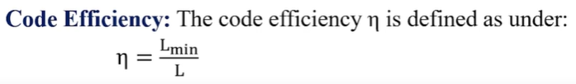
Length of the code word is the no of binary digits in the code word

Slide 19
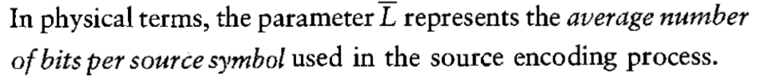
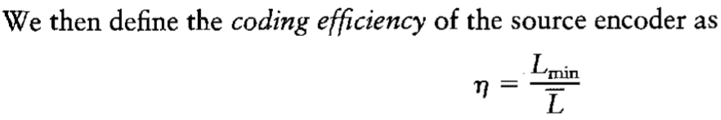
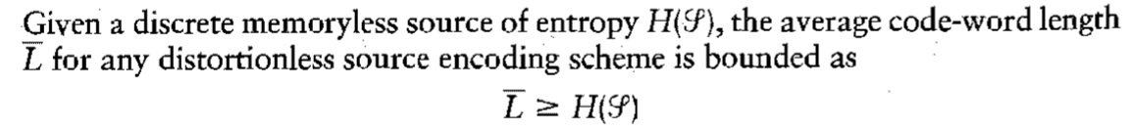
Source Encoder

Slide 20
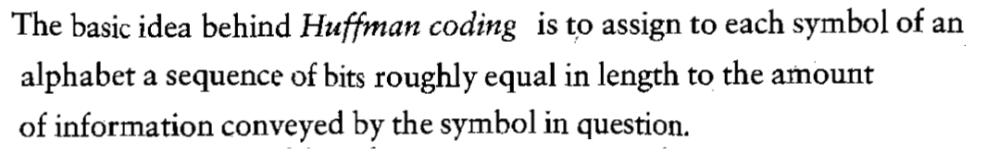
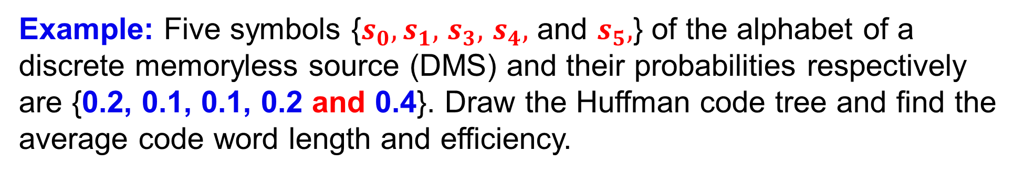
Huffman Coding
Example: Five symbols {$s_{0},s_{1},$ $s_{3},$ $s_{4},$ and $s_{5},$} of the alphabet of a discrete memoryless source (DMS) and their probabilities respectively are {0.2, 0.1, 0.1, 0.2 and 0.4}. Draw the Huffman code tree and find the average code word length and efficiency.

Slide 21
The source symbols are arranged in order of decreasing prob. Then the two of lowest probability are assigned bit 0 and 1.
Then combine last two symbols and move the combined Symbol as high as possible.
Repeat the above step untill end.
Code for each symbol is found by moving backward.
Calculation

Slide 22
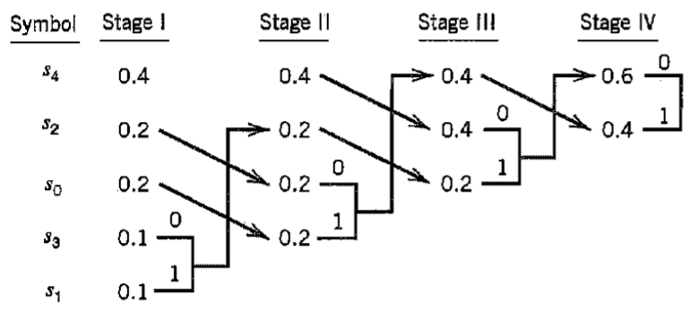
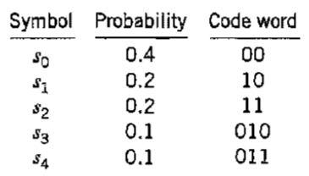
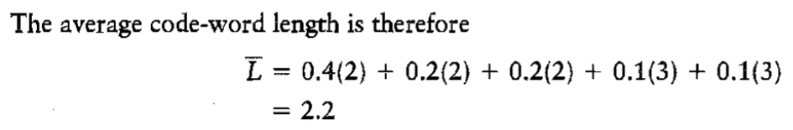

Slide 23
End

